Slide 1

Movie recommender system

Slide 2
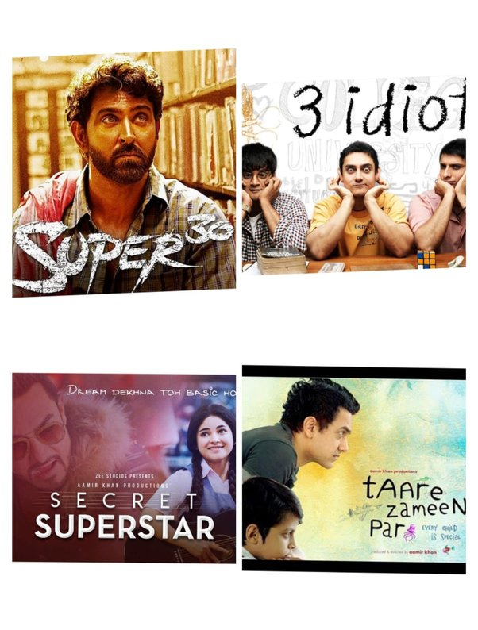
recommender system
INTRODUCTION
A machine learning algorithm known as a recommendation system combines information about users and products to forecast a user's potential interests. These systems are used in a wide range of applications, such as e-commerce, social media, and entertainment, to provide personalized recommendations to users.

Slide 3
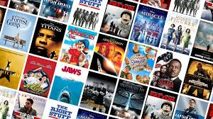
Types of Recommender system
Content-based filtering: This type of system uses the characteristics of items that a user has liked in the past to recommend similar items.
Collaborative filtering: This type of system uses the past behavior of users to recommend items that similar users have liked.
Hybrid: To generate suggestions, this kind of system combines content-based filtering and collaborative filtering techniques.
The type of recommender system is used is dependent on the type of application is used.

Slide 4

PROJECT FLOW OF RECOMMENDER SYSTEM
DATA : In the Movie Recommender System we have 2 CSV files .
1) tmdb_5000_credits.csv .
2) tmdb_5000_movies.csv.
PREPROCESSING : preprocessing of the CSV taken, to form a proper format.
MODEL BUILDING : Other steps that are required to build the project. Like Data preprocessing ,Vectorization and Main function.

Slide 5

Dataset & jupyter notebook setup
To setup we import ‘numpy’ and ‘pandas’.
Download the csv files that we need for the project.
Then read the CSV file we have choosed for the project with the variable ‘movie’ and ‘credits’.

Slide 6

Data preprocessing
Reading of 2 different data file differently with different variable.
In preprocessing we remove the missing values and redundant values from the data.
Then as we have 2 different data it is difficult to perform the task on 2 separate data so we merge the file to get a single data frame.
Then with the large data frame the required and interested columns are considered and create a new data frame.
Again we combine the taken columns into single column named as ‘Tags’.

Slide 7

vectorization
Combining all the words of columns to form a paragraph.
To avoid the words of same meaning we use ‘poster stemmer’.
Using ‘Count Vectorization’ we extract the text avoiding the stop words for accurate vectors.
Vectorization of words increase the accuracy of the recommender system.
Vectorization allows for the simultaneous processing of multiple data points, reducing the overhead associated with repeated function calls.
Vectorization facilitates feature extraction and transformation, enabling more sophisticated data preprocessing pipelines.
vectorization enhances the performance, efficiency, and maintainability of recommender systems in machine learning, making it a crucial technique for handling large-scale data and complex computations.

Slide 8
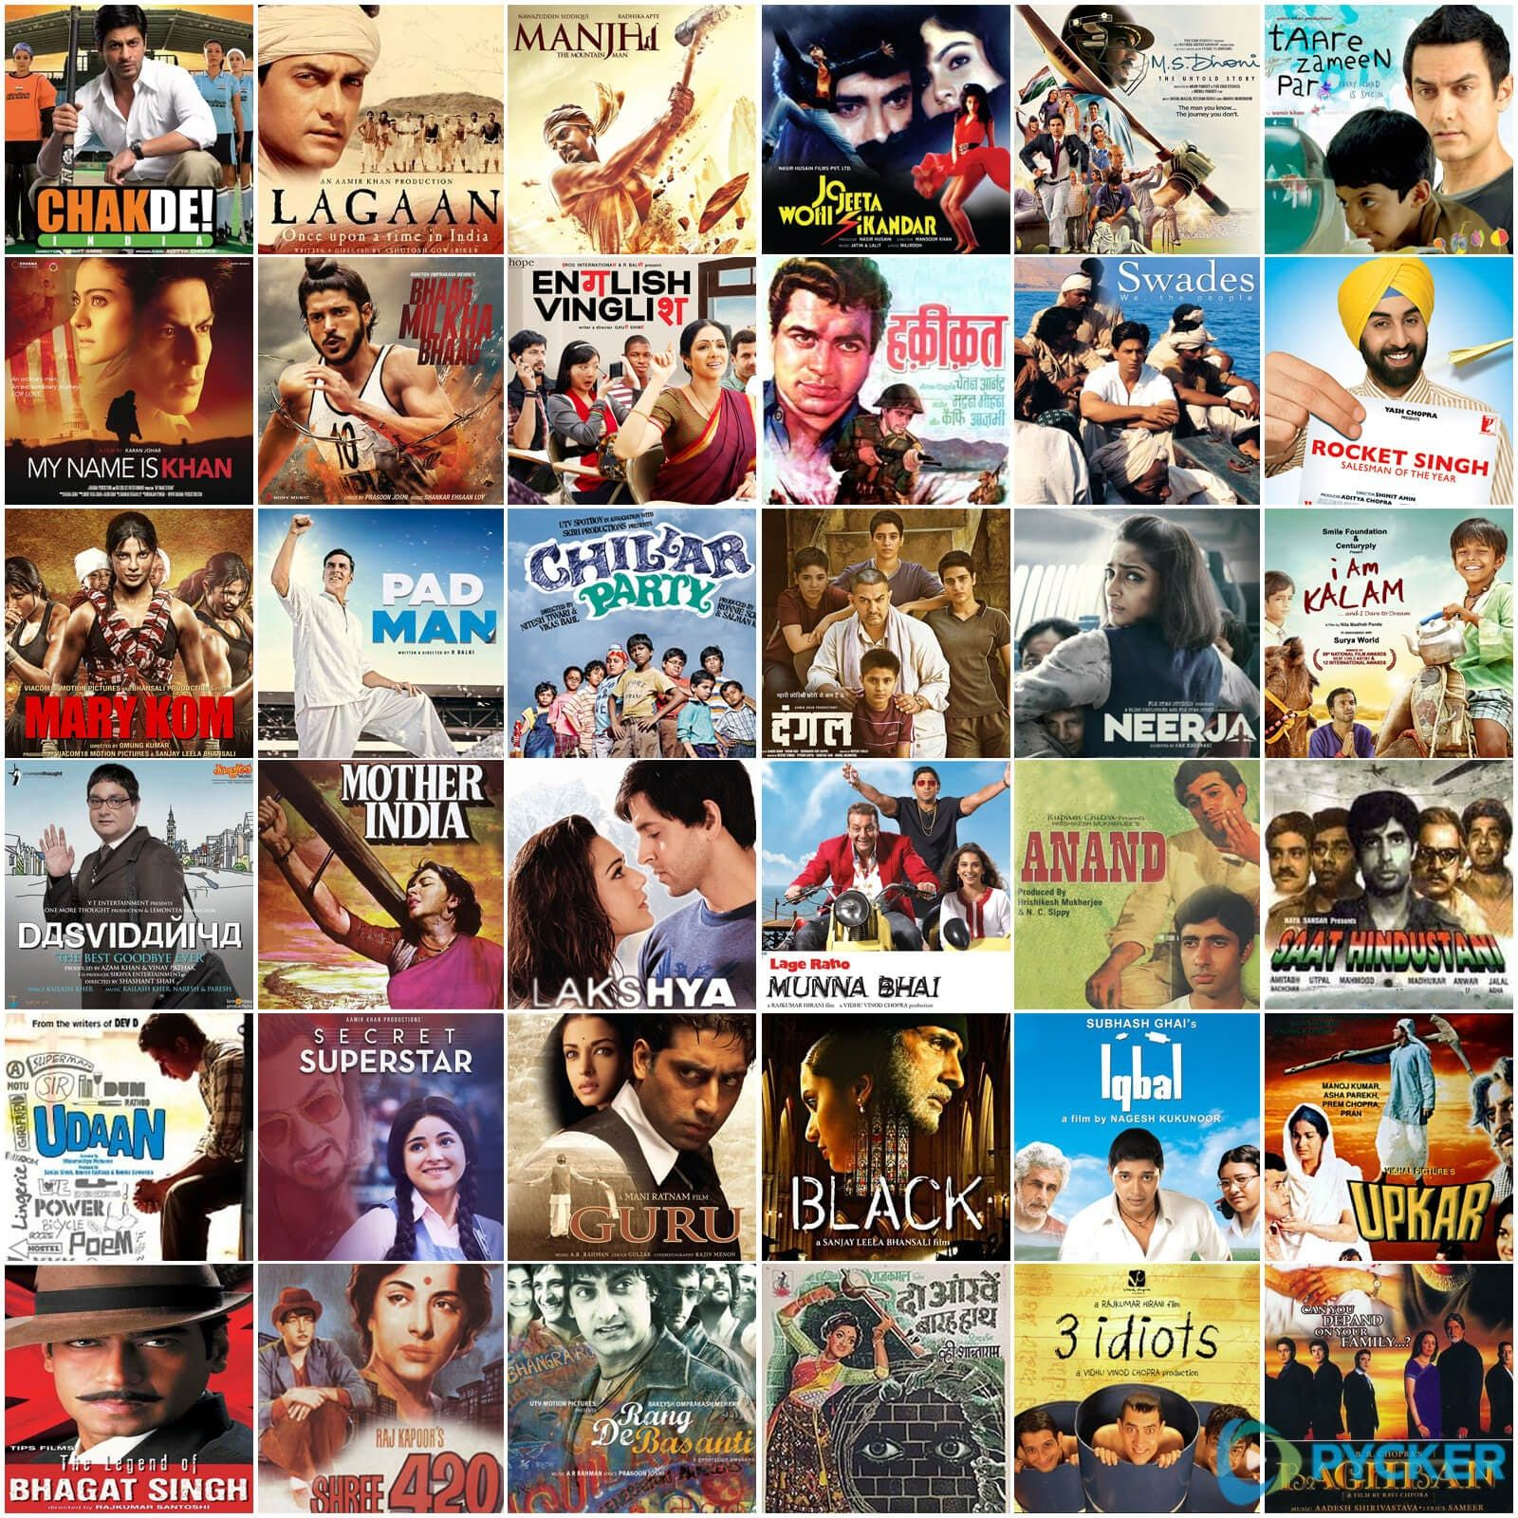
Main function
In main function by measuring the similarity between user vectors (representing user preferences) and item vectors (representing item features), the system can recommend items that are most aligned with a user's preferences.
It enables personalized recommendations by identifying items similar to those a user has previously liked or interacted with

Slide 9

Thank you

